Slide 1
CYBER SECURITY UPSKILLING PROGRAM قدم خلال مبادرة زنك/2 في جامعة البلقاء التطبيقية بالتعاون مع أكاديمية سايبر شيلد SEP 2024 Security Part Version 1
INST.:ENG.ALI BANI BAKAR-0778642376(CYBER SHIELD ACADEMY)
DONE BY: ENG. Dana Al-Mahrouk-0798697842-BAU.UNIV.

Slide 2
Outline
Networks
Linux Essentials
Cybersecurity Foundation
Ethical Hacking
Digital Forensic Investigation

Slide 3
Security
Outline:
Cybersecurity
Symmetric & Asymmetric Encryption
Hashing
HMAC
College Domaine
Digital Signature
HTTPS (TLS/SSL & CA)
CrypTool
Port Number
Penetration testing process

Slide 4
Day 11
Outline:
Cybersecurity
CIA
Symmetric & Asymmetric Encryption
Public & Private Key
Security Enhanced (SE)
Hashing
HMAC
College Domaine
Digital Signature
HTTPS (TLS/SSL & CA)

Slide 5
Cybersecurity
Cybersecurity is the practice of protecting computer systems, networks, and data from cyberattacks, unauthorized access, and damage.
Network ➔ TCP/IP, OSI
Cyber ➔ CIA
Confidentiality: Ensures that sensitive data is accessible only to authorized individuals and remains private. (Encryption, Access control, and Authentication)
Integrity: Verifying the validity of the data, does not guarantee the integrity and protection of the data, only informing you if the data has been tampered with or not. (Hashing algorithms and Digital signatures)
Availability: Ensures that systems, networks, and data are available when needed by authorized users. (Redundancy, Fault tolerance, and Regular backups to prevent outages)

Slide 6






Encryption
used to protect data by converting it into a format that cannot be easily read by unauthorized users.
Encryption
Clear Text
Cipher Text

Slide 7
Symmetric Encryption
the same key is used by the sender and receiver to both encrypt and decrypt the data.
fast and efficient, especially for large amounts of data.
Both sender and receiver must securely exchange the secret key. If the key is intercepted, the encryption is compromised.

Slide 8

Symmetric Encryption
Shared Secret Key
Encryption
Decryption
Clear Text
Cipher Text
Clear Text

Slide 9
Asymmetric Encryption
uses a pair of keys a public key is shared for encryption and a private key kept secret by the receiver for decryption and both are mathematically linked.
Slower than symmetric encryption due to the complex mathematical operations involved.
Used for secure key exchange (e.g., in SSL/TLS protocols), digital signatures, and encrypting small pieces of data such as passwords.

Slide 10




Asymmetric Encryption
Sender
Receiver
Encryption
Decryption
Clear Text
Cipher Text
Clear Text
Public sender key
Public receiver key
Private sender key
Private receiver key

Slide 11


Asymmetric Encryption
Sender
Receiver
Decryption
Encryption
Clear Text
Cipher Text
Clear Text
Public sender key
Public receiver key
Private sender key
Private receiver key

Slide 12


Asymmetric Encryption Steps
Generate two pair of keys in sender & receiver dependent on a random value.
Sender
Receiver
Random Value
Random Value
Public sender key
Private sender key
Public sender key
Private sender key

Slide 13
Asymmetric Encryption Steps
Exchange the public keys.
Public sender key
Sender
Receiver
Public sender key

Slide 14
Asymmetric Encryption Steps
Encryption using the receiver public key.
Sender
Encryption
Clear Text
Cipher Text

Slide 15
Asymmetric Encryption Steps
Decryption using the receiver private key.
Receiver
Decryption
Cipher Text
Clear Text

Slide 16


Symmetric VS Asymmetric
 | Symmetric | Asymmetric
Generate | One shared secret key | Sender & Receiver ➔ pair public & private keys
Encryption | Secret key | Receiver public key
Decryption | Secret key | Receiver private key
Security
Speed
Key length | Small | Big
Process & resources | Low | High
Example | AES, DES, 3DES | RSA, ECC, DSA

Slide 17
Security-Enhanced Linux
Security-Enhanced Linux (SELinux) is a Linux kernel security module that provides a mechanism for supporting access control security policies.
SELinux enforces security policies defined by system administrators. This limits what actions programs and users can perform on a system.
SELinux allows for very detailed and specific control over access to files, processes, and other system resources. You can define which programs are allowed to access particular files and directories, network ports, or perform certain tasks.

Slide 18
SELinux Modes
Enforcing: enforces the policy and blocks any actions that are not permitted by the policy.
Permissive: does not block actions, but it logs violations that would have been blocked in enforcing mode. This is useful for testing and troubleshooting policies.
Disabled: turned off, and no policies are enforced.

Slide 19
Web Encryption
Q: in web encryption choose Symmetric or Asymmetric?
A: Hybrid ➔ HPPTS → TLS/SSL
Slove “pre-share key” using Asymmetric Encryption.

Slide 20


Integrity
Ensuring that the data is delivered safely without modification to the recipient of the message
Ensuring the validity of the data, does not guarantee the integrity and protection of the data, only informing you if the data has been tampered with or modified or not.
If the modification has been made, it informs you that this data has been modified and is not valid
Without integrity
With integrity
This is valid ➔ no change in data
I don’t know if this is valid or not
This is invalid ➔ there are change in data

Slide 21
Hashing
Hashing is a one-way cryptographic function that transforms the password into a fixed-length string of characters.
Once a password is hashed, it cannot be easily reversed back to its original form.
When a user logs in, the system hashes the entered password and compares it to the stored hash to verify the user’s identity.
In the past, Active Directory used encoding and reversible encryption methods to store passwords, but modern systems, including Active Directory, now rely on hashing to securely store passwords.

Slide 22
Hashing Password
Username | Password (past) | Password (now) Hash MD5 | Password (now) Hash MD5 with salt = “salt123”
Dana | 1234 | 81 DC 9B DB 52 D0 4D C2 00 36 DB D8 31 3E D0 55 | A9 24 F5 95 B7 A8 21 0C 29 1E 05 71 AC 0D 34 4E
Mohammed | abcd | E2 FC 71 4C 47 27 EE 93 95 F3 24 CD 2E 7F 33 1F | 40 4A B4 2F 2F C9 34 66 46 01 B6 15 B7 5B E2 1C
Obada | pass | 1A 1D C9 1C 90 73 25 C6 92 71 DD F0 C9 44 BC 72 | 62 CE 61 B4 6C 6F 7B 0C D3 D8 57 FD 84 DD D2 6C
To securely store passwords in a database, it's essential to hash them before saving them.
Additionally, using a technique called "salting" with the hash function can further enhance security, A “salt” is a random string that is added to the password before hashing.
If a hacker steals the databases, he will find the passwords hashed, and he will need many techniques and a lot of time to find out what the clear password is.

Slide 23


How Hashing Work
SHA 256
Clear Text
Hash Function
Hash Value
(Input)
Hashing Algorithm
(Output)

Slide 24





How Hashing Work
SHA 256
Sender
Comparator
Hash Value 1
Hash Function
(Output)
H1 == H2
Yes, or No?
SHA 256
Clear Text
(Input)
Receiver
Hash Value 2
Hash Function
(Output)

Slide 25

HMAC (Hash-based Message Authentication Code)
SHA 256
Sender
Comparator
Hash Value 1
Hash Function
(Output)
H1 == H2
Yes, or No?
SHA 256
Clear Text
(Input)
Receiver
Hash Value 2
Hash Function
(Output)

Slide 26
HMAC (Hash-based Message Authentication Code)
is a mechanism that combines a cryptographic hash function with a secret key to provide data integrity and authentication. It's often used in securing communications, ensuring that the message has not been tampered with and verifying the identity of the sender.

Slide 27
Collagen Domain
Q: Hash value is unique?
For a 3-bit hash value ➔ P(Ali | Mohammed) = 1/8 *1/8 = 1/16 ➔ 1.5%
For 256 bit ➔ 1/ 2^256 * 1/ 2^256 = 1/ 2^512 ➔ 7.4*10^-195
INDEX | VALUE
000 | Dana
001 | Mohammed
010 | Noor
011 | Obada
100 | Aseel
101 | Leen
110 | Akram
111 | Malik
Ali
Hash Function
/Ali
Esra’a
/Ahmad
Ahmad

Slide 28
Collagen Domain
If a hacker creates a malicious program, disguises it as legitimate software, and manages to replace the original on a popular download site, multiple issues can arise, especially if the malicious file's hash is being changed and the firewall doesn't detect it.
Hash Collision: A skilled attacker could theoretically create a malicious file with the same hash as the legitimate one, This is rare but can occur and would bypass basic integrity checks.

Slide 29






Collagen Domain
Malware
Successfully
Downloaded
Malware
Hash Value
Hacker
Program
Program
Program
Hash Value
Malware that have hash value as same legal program
Program
Hash Value
Program deleted by hacker
Legal web Page
User

Slide 30
Hash Value
Salting: Adds randomness to the password before hashing, this ensures that even if two users have the same password, their hashes will be different, making it more resistant to attacks like rainbow table attacks.
Peppering: Adds a secret value (known only to the server) to further randomize the hash, enhancing security.

Slide 31


Digital Signature
is a cryptographic technique used to ensure the authenticity and integrity of a message. It verifies that the file or message has not been altered since it was signed by the legitimate sender, ensuring trust in digital communications (Non-denial agreement).
SHA 256
Documentation
Hash Value
Encryption
(Output)
(Input)
Hash Function
Public sender key
Private sender key

Slide 32


Comparator
H1 == H2
Yes, or No?
(Output)
Hash Value
Decryption
SHA 256
Hash Value 2
(Output)
Documentation
Hash Function

Slide 33

HTTPS (Hypertext Transfer Protocol Secure)
Encryption: HTTPS uses encryption to scramble the data exchanged between the browser and the web server so that it can only be read by the intended recipient.
Authentication: HTTPS also ensures that the website the user is communicating with is authentic and not an impostor.
Integrity: Data transmitted via HTTPS cannot be modified or corrupted during transfer without being detected.

Slide 34
CA (Certificate Authority)
is a trusted organization that issues digital certificates. These certificates are used to authenticate the identity of websites, companies, or other entities and to secure communications through encryption.
Role of the CA: The CA acts as a trusted third party that verifies the identity of an entity requesting a certificate (e.g., a website). Once verified, the CA issues an SSL/TLS certificate to the entity.
Digital Certificates: These certificates contain the public key needed for encryption and are typically signed by the CA's private key. This confirms that the certificate is legitimate.

Slide 35
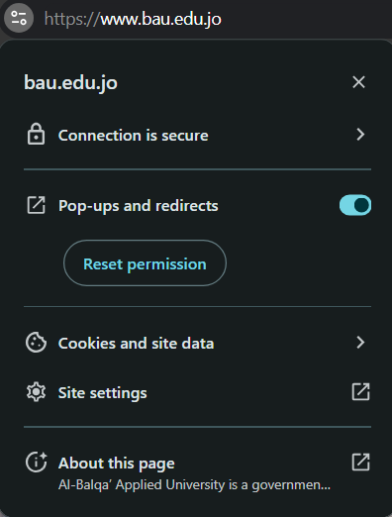
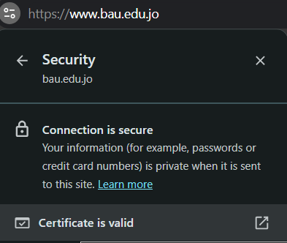

TSL/SSL (Transport Layer Security / Secure Sockets Layer)
are cryptographic protocols that provide secure communication over a computer network, such as the internet.

Slide 36
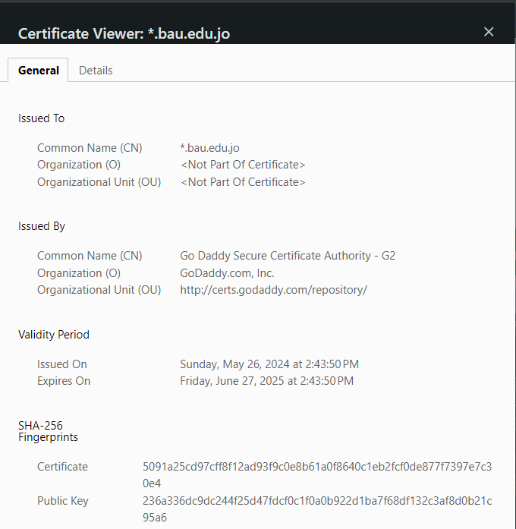

Slide 37
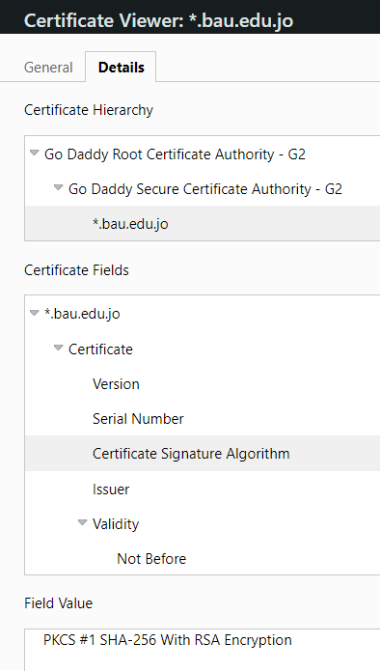
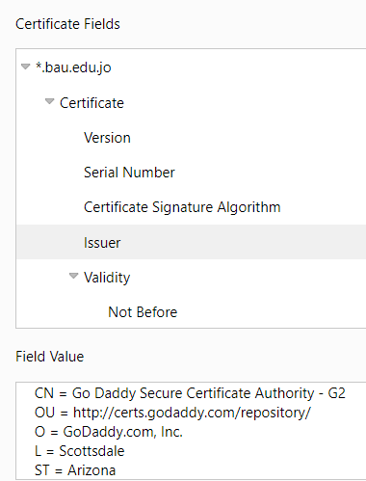
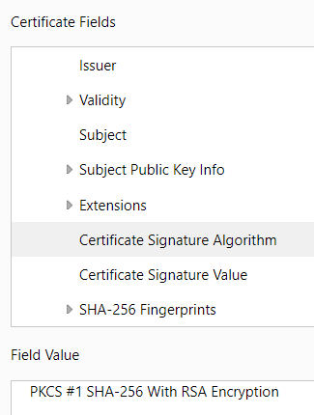

Slide 38
Day 12
Outline
Rainbow Table
CrypTool
SHA-256
Caesar
Symmetric Encryption → 3DES
Asymmetric Encryption → RSA
HTTPS (TSL/SSL)
Steps
Wireshark
Port Number
Hack value → Risk Rank
Exploit
Expansion
Patch

Slide 39
Day 12
Outline
Penetration testing process
Reconnaissance (Information Gathering)
Scanning and Enumeration
Exploitation
Privilege Escalation
Post-Exploitation
Lateral Movement
Covering Tracks
Reporting

Slide 40
Rainbow table attack
is a cryptographic attack that leverages precomputed tables containing hash values and their corresponding plaintext values.
Instead of computing a hash for every possible input during an attack (which would be computationally expensive) ➔ the attacker compares the target hash against the precomputed values stored in the rainbow table.
If a match is found, the attacker has successfully identified the original plaintext that created the hash, effectively "cracking" the hash.

Slide 41

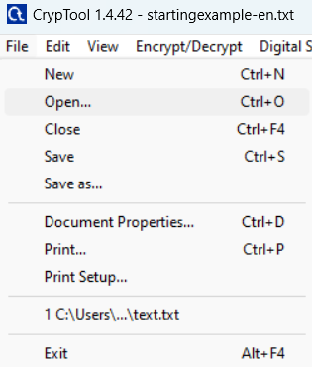
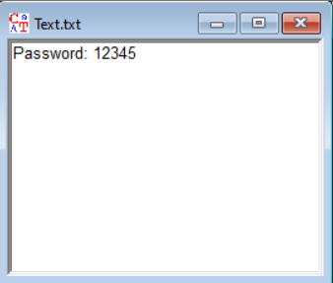
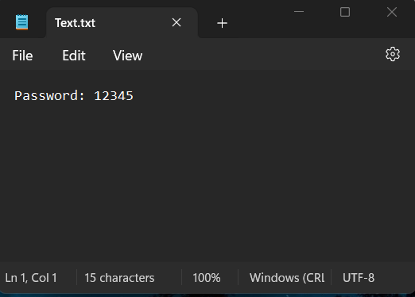
CrypTool
is an open-source educational software that visualizes cryptographic algorithms and techniques. It helps users learn about encryption, decryption, and cryptographic protocols through interactive tutorials and simulations.

Slide 42
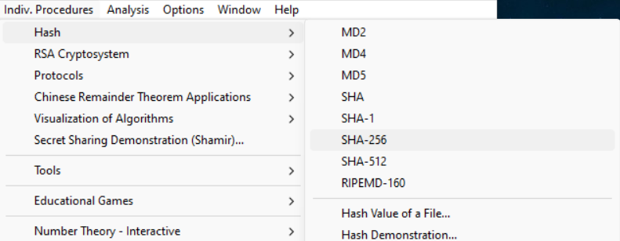
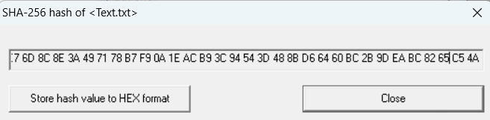
SHA-256

Slide 43
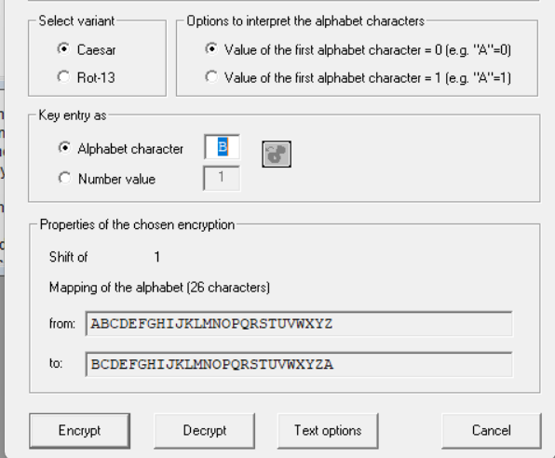
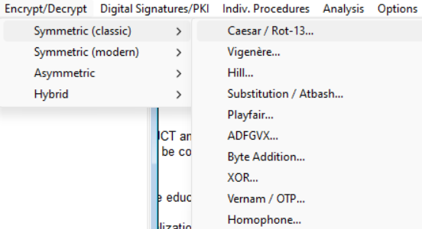
Caesar

Slide 44
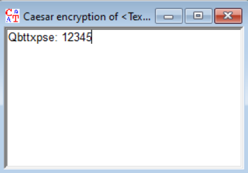
Weak Encryption
All types of substitution encryption can be solved using language algorithms:
1) Most frequent letters (the frequency of letters in the language)
2) Letters that are difficult to be in the same word
3) Most frequent words
4) Guessing words from context

Slide 45
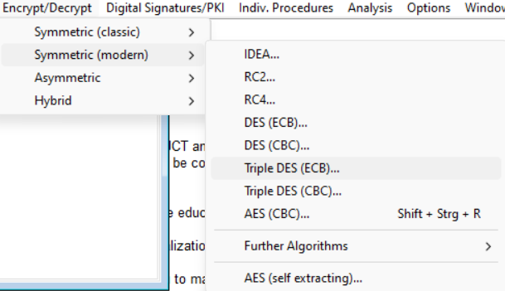
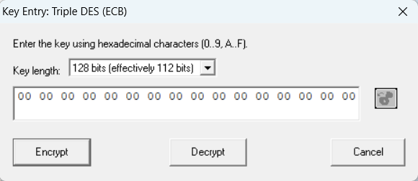
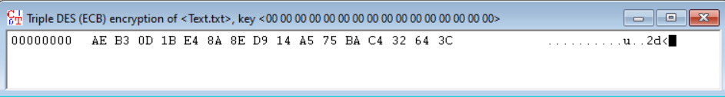
Symmetric Encryption
Key Length is not important.
<address> <Hexadecimal> <ASCII>

Slide 46
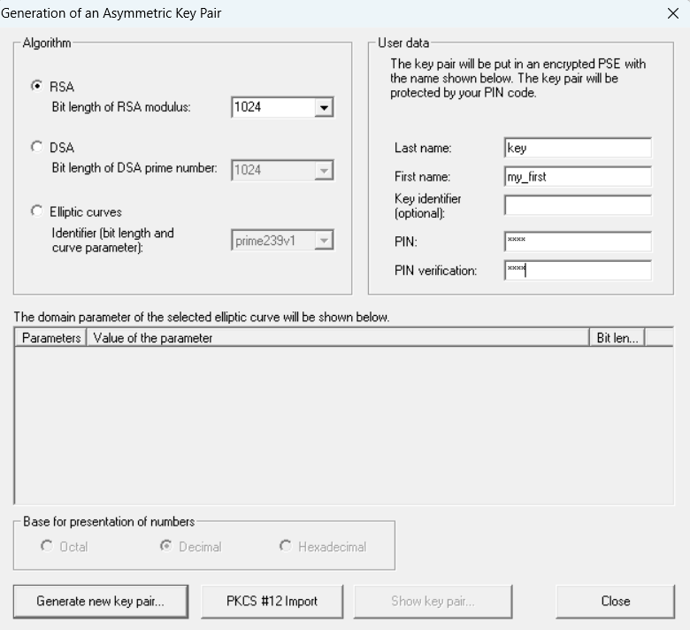
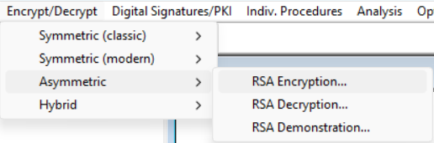
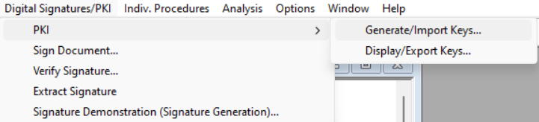
Asymmetric Encryption
You must generate pair key

Slide 47
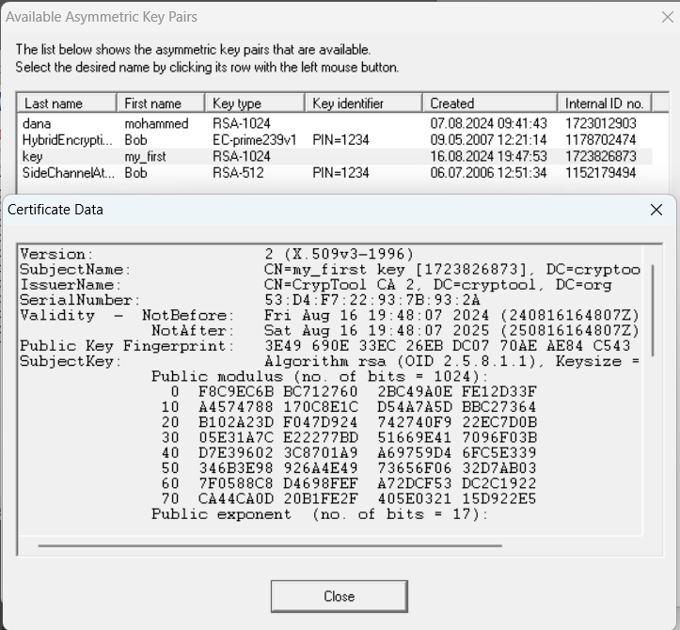

Slide 48
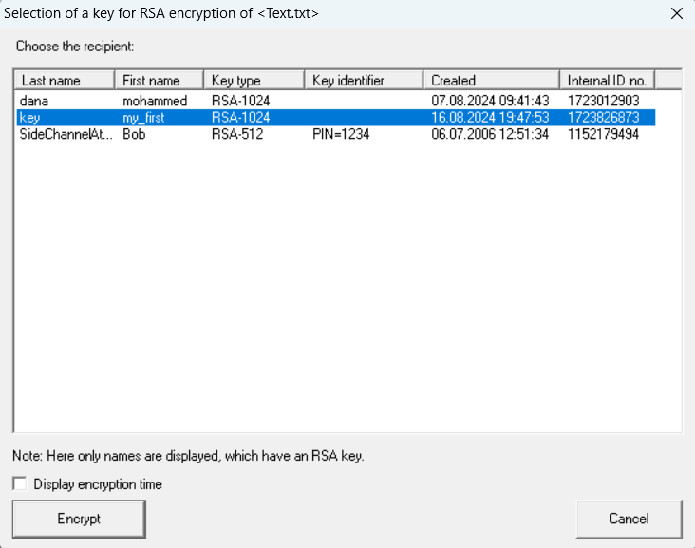
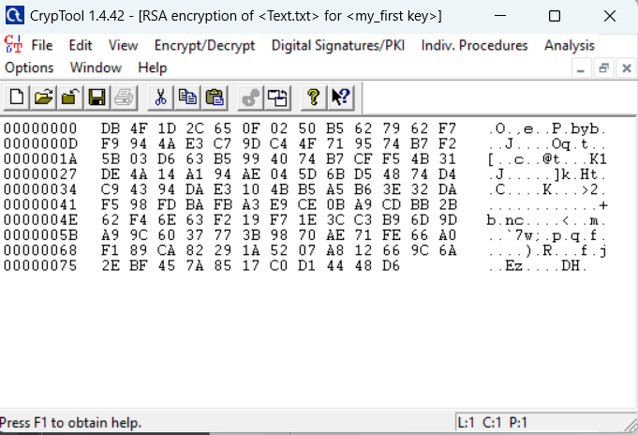
Use your public key for encryption

Slide 49
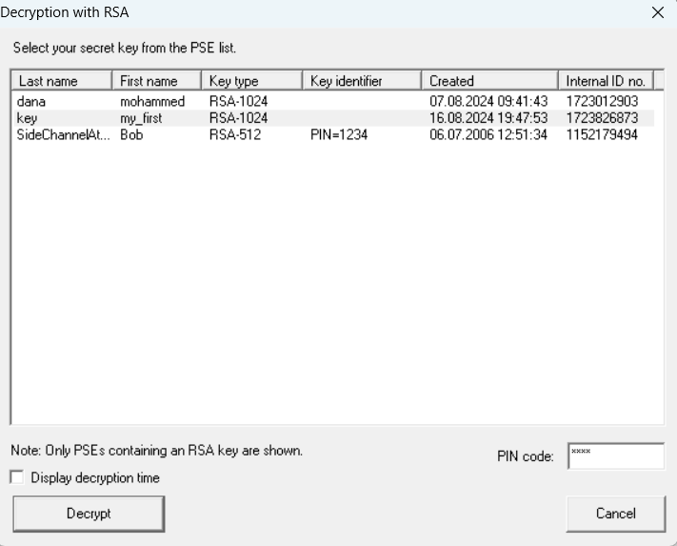
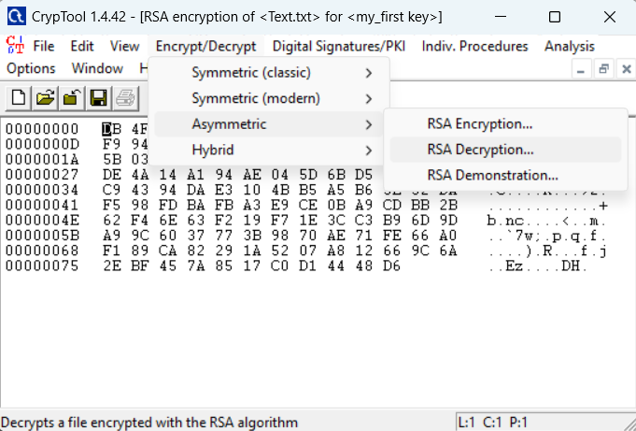
Asymmetric Decryption

Slide 50
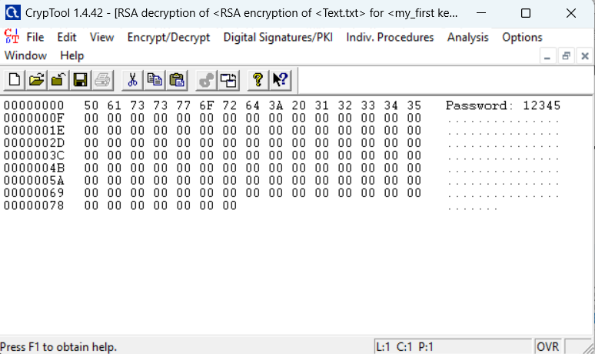
Well Done

Slide 51
HTTPS (TSL/SSL)
HPPTS (Hypertext Transfer Protocol Secure): used for secure communication over a computer network, particularly the internet.
Encryption: Data exchanged between the client and server is encrypted, preventing eavesdropping or man-in-the-middle attacks.
Data Integrity: Ensures that the data has not been altered or tampered with during transmission.
Authentication: Confirms that the client is communicating with the legitimate server, preventing impersonation attacks.
TLS/SSL (Transport Layer Security/Secure Sockets Layer): are cryptographic protocols designed to provide secure communication over a network. TLS, which is more secure and still in use today.

Slide 52
HTTPS Steps
Generate two pair of keys in sender “Client” dependent on a random number. (internal process)
Client
Web Server
Random Number
RNs
RNr
Random Number
Public sender key
Private sender key
Public sender key
Private sender key

Slide 53
HTTPS Steps
Client Hello message ➔ Random number + Crypto information
Client Send the Random Number.
RNs
Random Number
Client
Web server
Public sender key
Public receiver key
Private sender key
Private receiver key

Slide 54
HTTPS Steps
Generate two pair of keys in receiver “Web Server” dependent on a random number. (internal process)
Web Server
RNr
Random Number
Public sender key
Private sender key

Slide 55
HTTPS Steps
Server Hello message ➔ Random number + Crypto information
RNs
Client
Web server
RNr
RNs
Random Number
RNr

Slide 56

HTTPS Steps
Web server send its public key & Certificate info.
Client check web server Certificate.
RNs
Certificate info
Client
Web server
RNr
RNr
RNs
Public receiver key

Slide 57

HTTPS Steps
Client send its public key.
Web server check client Certificate.
RNs
Public sender key
Sender
Receiver
RNr
RNr
Certificate info
RNs

Slide 58


HTTPS Steps
Client generate random number pre-master secret key ➔ PMS
Client hash over all previous messages using singed by client private key
PMS
PMS
PMS
RNs
Sender
Receiver
RNr
RNr
RNs
Encryption
Decryption

Slide 59
HTTPS Steps
Web server check hashing & signature
Now client is authenticated in web server
PMS
PMS
RNs
Sender
Receiver
RNr
RNr
RNs
Client is authenticated

Slide 60
HTTPS Steps
Client & web server calculate Master Secret Key from
➔ ➔
PMS
RNs
RNr
MS
PMS
PMS
MS
MS
RNs
Sender
Receiver
RNr
RNr
RNs

Slide 61

HTTPS Steps
Exchange data in Symmetric Encryption using Master Secret Key
PMS
PMS
MS
MS
RNs
Sender
Receiver
RNr
RNr
RNs
Encryption
Decryption

Slide 62
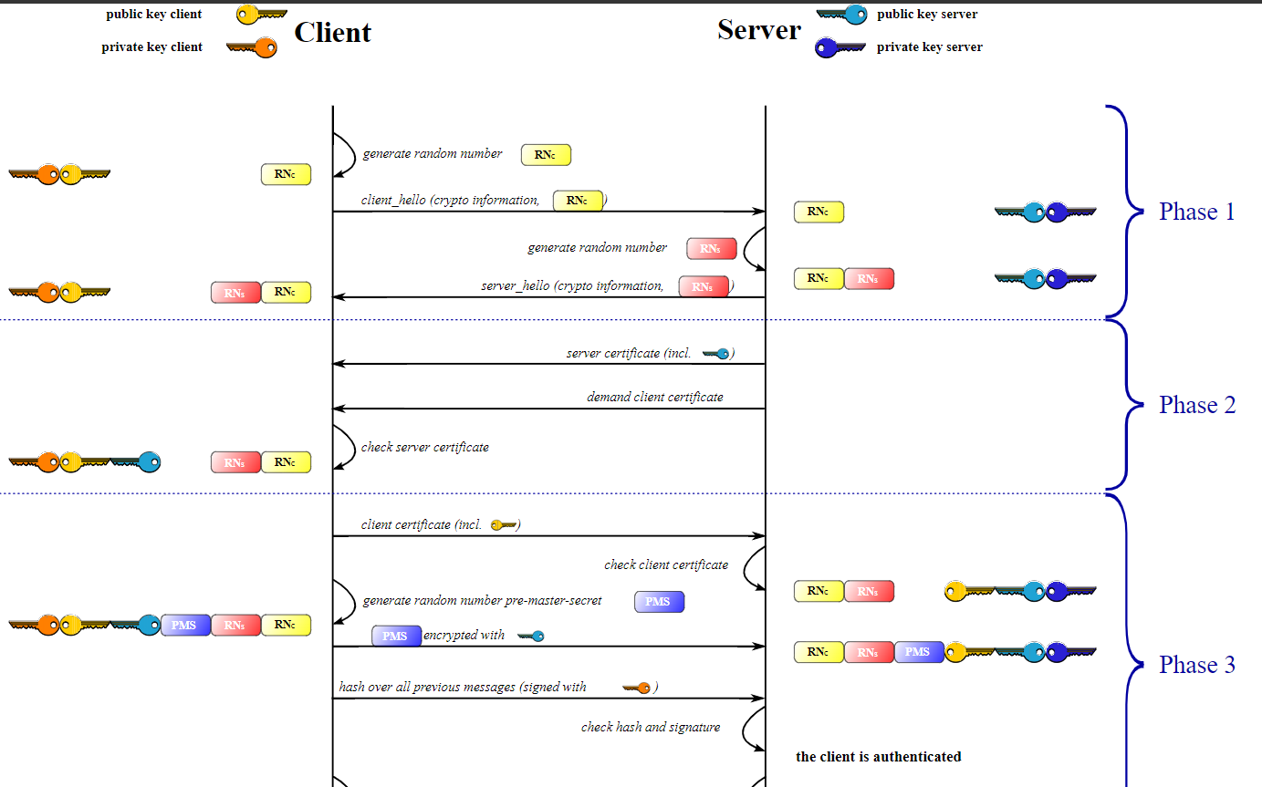

Slide 63
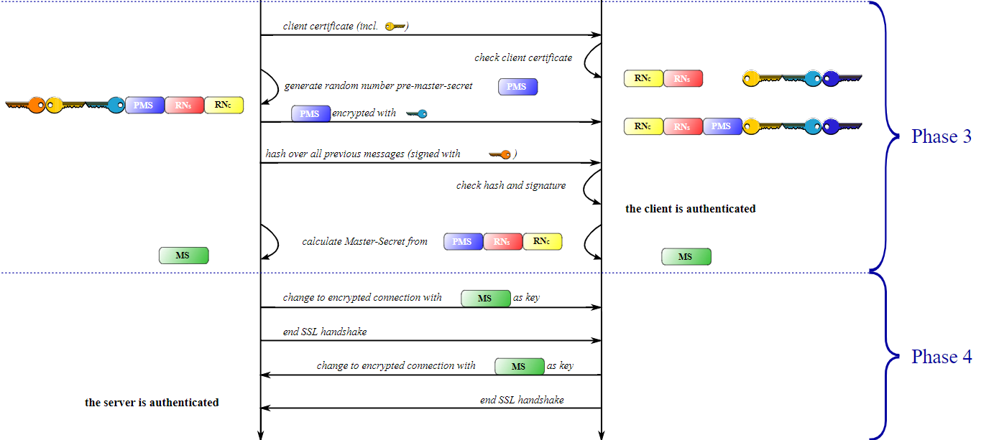

Slide 64
Wireshark
Open Wireshark ➔ Wi-Fi
Go to google chrome ➔ open web page that you have never open it.

Slide 65
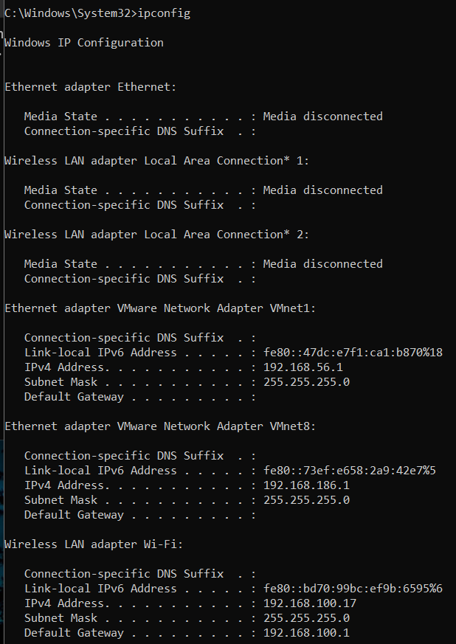
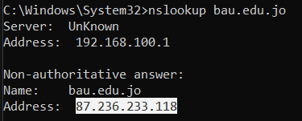
CMD Command
ipconfig
nslookup <DNS name>

Slide 66
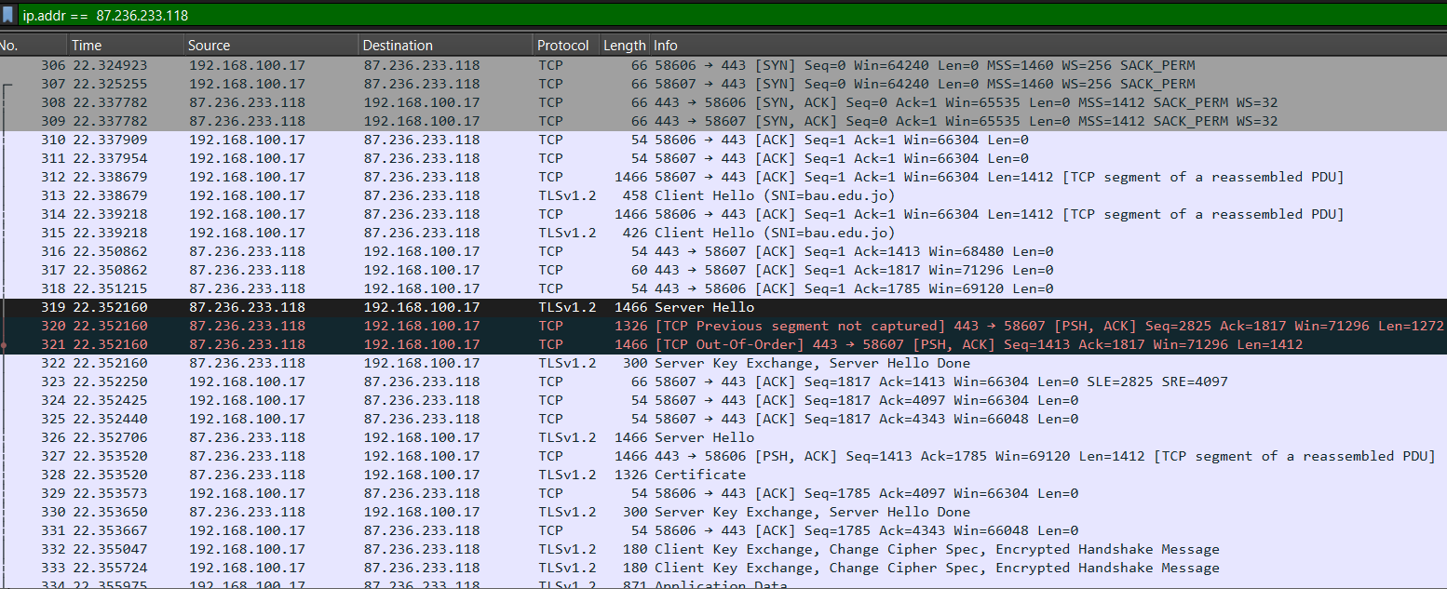
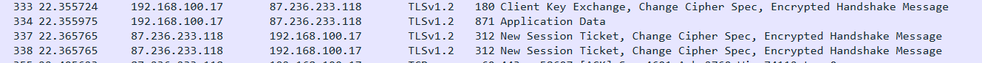
Open a HTTPS page ➔ bau.edu.jo
3-way handshak

Slide 67
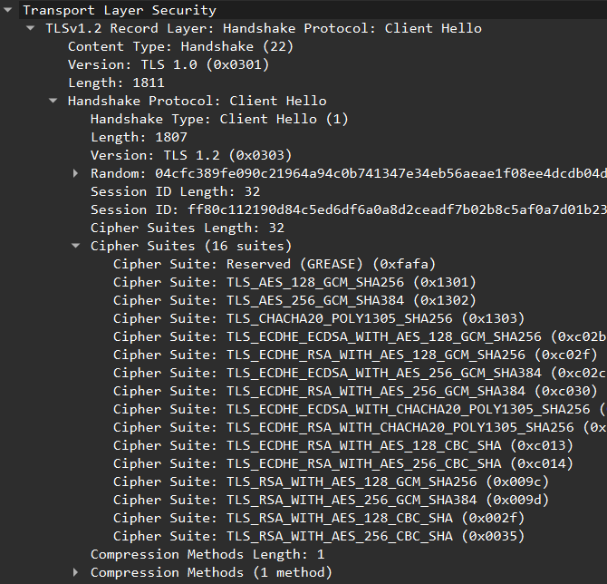
Client Hello Message
Version: The client specifies the highest version of the TLS/SSL protocol it supports
Random Number: (typically 32 bytes) is generated by the client and sent to the server.
Session ID: If the client is attempting to resume a previous session, it includes a session ID. If this is the first time the client is connecting to the server, the session ID is usually empty.
Cipher Suites: The client sends a list of supported cryptographic algorithms.
…

Slide 68
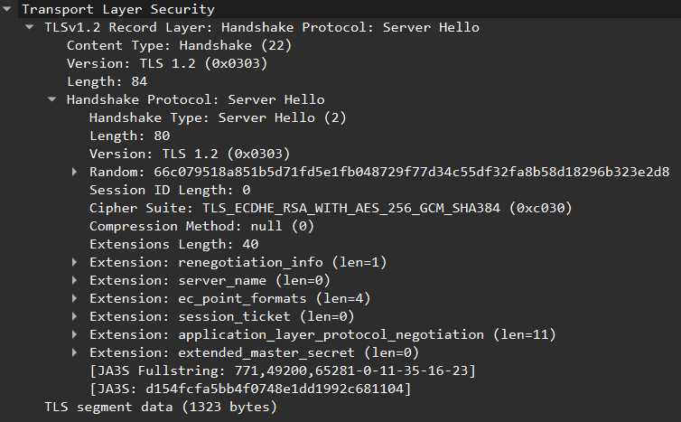
Server Hello Message
Version: The server specifies the TLS/SSL protocol version that will be used for the session.
Random Number: The server generates and sends a random number (32 bytes) to the client.
Session ID: If the client included a session ID in the Client Hello, and the server recognizes it, it will use the same session ID to resume the session. Otherwise, it creates a new session ID.
Cipher Suite: The server selects one cipher suite from the list provided by the client.

Slide 69
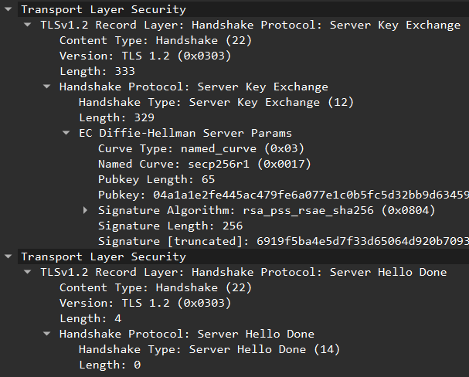
Server key Exchange, Server Hello Done
(ECDHE): the server sends the elliptic curve parameters and its public key.
DH Parameters: (prime number), (generator), and the server’s public value.
EC Parameters: Curve name, server’s public key on the curve.
Digital Signature: The server signs the key exchange parameters with its private key. This signature ensures that the key exchange parameters are authentic and were sent by the legitimate server.
Server Hello Done message: is a simple message sent by the server to indicate that it has finished sending all the necessary information for the handshake process.

Slide 70
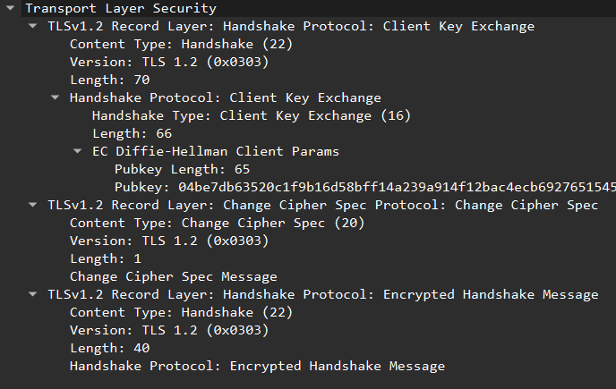
Client key exchange, Change cipher spec, Encrypted Handshake Message
RSA (Pre-TLS 1.3):
The client generates a pre-master secret, a random value that both the client and server will use to derive the session keys.
The client encrypts this pre-master secret using the server’s public key, which was obtained from the server's digital certificate.
The encrypted pre-master secret is sent to the server.
The client generates its own Diffie-Hellman or Elliptic Curve Diffie-Hellman public key.
This public key is sent to the server.

Slide 71
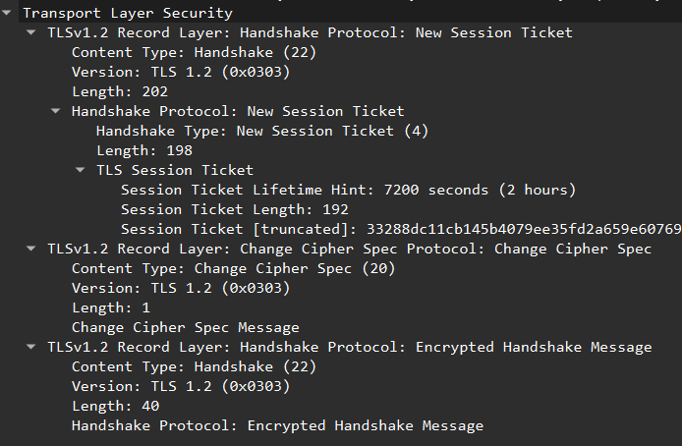
New Session Ticket, Change cipher spec, Encrypted Handshake Message
New Session Ticket message: used to support session resumption. typically sent by the server to the client after the initial handshake.
Change Cipher Spec message: is a brief message sent by both the client and server to signal that all subsequent messages will be encrypted using the session keys that were just negotiated during the handshake.
Encrypted Handshake Message (Finished Message): is the final step that confirms the integrity of the handshake process and indicates that the handshake was successful.

Slide 72

Port Number
Port states:
Open port ➔ Vulnerability
Closed port
Filtered port
Hack value ➔ (r--, rw-, rwx)
Execute ➔ if you have a Script, you can execute it

Slide 73



Hack value → Risk Rank
Hack Value: worth of a system, target, or vulnerability to an attacker. High hack value means that the target is appealing to hackers, either because of the data it holds or the impact of exploiting it.
Risk Rank: is a method used to prioritize vulnerabilities based on their severity and potential impact on the organization. This ranking typically considers factors like likelihood of exploitation, the potential damage, and the value of the assets involved.

Slide 74





Exploit
An exploit is a method or tool used by attackers to take advantage of a vulnerability in a system.
Exploits can be software, a piece of code, or even a series of steps that result in unauthorized access, data theft, or system damage.

Slide 75


Expansion
expansion of an attack after the initial breach.
Once a vulnerability has been exploited, attackers often try to expand their access to other parts of the system or network, also known as "lateral movement."

Slide 76
Patch
A patch is a software update or fix designed to correct vulnerabilities or flaws in a system.
Patching is critical to preventing exploitation of known vulnerabilities.

Slide 77
Penetration testing process
Reconnaissance (Information Gathering)
Scanning and Enumeration
Exploitation
Privilege Escalation
Post-Exploitation
Lateral Movement
Covering Tracks
Reporting

Slide 78






1. Reconnaissance (Information Gathering)
Collect information about the target to prepare for the attack.
Passive Reconnaissance: Involves gathering information without interacting with the target directly. Examples include Google searches, WHOIS lookups, checking social media, and DNS queries.
Active Reconnaissance: Involves direct interaction with the target, such as using tools like Nmap to probe the target’s network and services.
Tools: Shodan, Maltego, FOCA, theHarvester, WHOIS, Google Dork.

Slide 79





2. Scanning and Enumeration
Identify open ports, services, and potential vulnerabilities in the target.
Scanning
Network Scanning: Uses tools to detect live systems, open ports, and services.
Vulnerability Scanning: Scans for known vulnerabilities on the systems and services identified in the previous step.
Enumeration: Involves extracting detailed information from the system, such as usernames, shared folders, or service versions.
Tools: Nmap, Nessus, OpenVAS, Netcat, Nikto, enum4linux.

Slide 80
2. Scanning and Enumeration
Q: why Scanning and Enumeration in different steps?
More time & traffic load & Firewall and Intrusion Detection System (IDS) Detection
Scanning
Enumeration
IP Scanning
[alive]
Port Scanning
[open | close]
[service name]
More details
[version]

Slide 81




3. Exploitation
- This phase involves using the information gathered during scanning and enumeration to exploit vulnerabilities. The goal is to gain control of the target system, typically by gaining access to the operating system, application, or network.
Tools: Metasploit, ExploitDB, SQLMap, Hydra, John the Ripper

Slide 82



4. Privilege Escalation
Gain higher levels of access or control within the compromised system.
- After gaining initial access, attackers often seek to escalate their privileges to obtain full control over the system. This might involve exploiting known vulnerabilities, misconfigurations, or weak security policies to gain administrative or root access.
Tools: Metasploit, PowerShell Empire, LinPEAS, GTFOBins

Slide 83

5. Post-Exploitation
Maintain access and gather valuable information from the compromised system.
- This phase involves actions such as data exfiltration, creating backdoors, and maintaining persistent access. The attacker might also attempt to move laterally across the network to compromise additional systems.
Tools: Mimikatz, Cobalt Strike, PowerShell Empire, Netcat

Slide 84
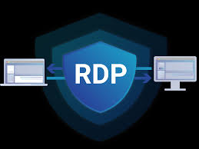

6. Lateral Movement
Move from the initially compromised system to other systems within the network.
- Attackers explore the network to identify and compromise additional targets, expanding their control within the network. This often involves exploiting trust relationships between systems or using stolen credentials.
Tools: PsExec, WMI, Pass-the-Hash, RDP, BloodHound

Slide 85

7. Covering Tracks
Erase or obscure evidence of the attack to avoid detection.
- After achieving their goals, attackers often try to cover their tracks to avoid detection. This may include deleting logs, hiding files, or altering timestamps.
Tools: Metasploit, PowerShell, log management tools

Slide 86
8. Reporting
Document and communicate the findings of the penetration test.
- The final phase involves creating a detailed report that includes all findings, including vulnerabilities discovered, exploits used, and recommendations for remediation. This report is typically provided to the organization’s security team or management.

Slide 87

Thank You

